Slide 1
LF2 Reinforcement-Learning
Team: AliceChienChien

Slide 2
Model
Input(shape=61,)
Dense(64, activation=relu)
Dense(64, activation=relu)
Dense(32, activation=lrelu)
Dense(12)

Slide 3
Environment
Observation
Delta x
Delta z
Facing
State
Background boundary
Previous action

Slide 4
Reward
Reward by hit
Hit enemy +2.0
Be attacked -1.0
At background boundary -0.1

Slide 5
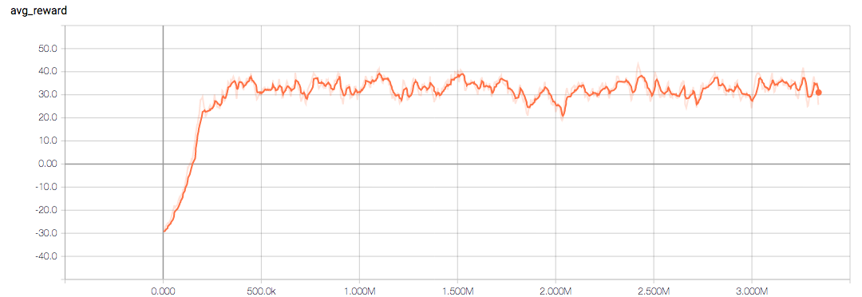
Average Reward
1 episode about 50k steps

Slide 6
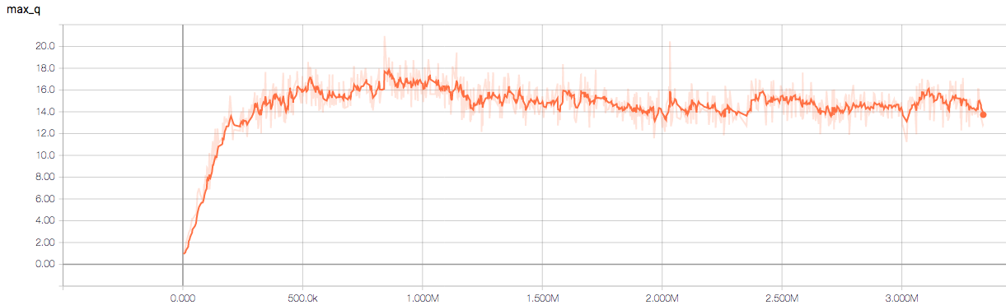
Max Q

Slide 7
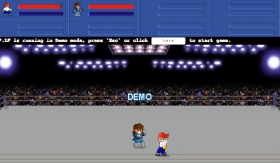
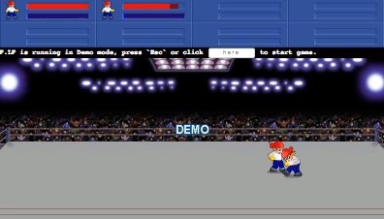
Demo
Episode=100 (Step=50k)
Episode=1190 (Step=668k)

Slide 8
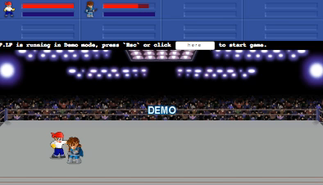
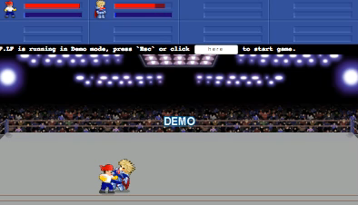
Demo
Episode=1590 (Step=875k)
Episode=5420 (Step=3093k)

Slide 9
Win Rate
Episode=5420 (step=3093k)
Enemy Win Rate(avg 20 ep.)
Bandit 0.95
John 0.65
Deep 0.8
Firen 0.7
Dennis 0.75
Davis 0.3
Freeze 0.95
Woody 0.25
Louis 1.0
Total 0.71

